Slide 1




Design and verification of collaborative robots system
CPS & IoT’2021 Summer School on
Cyber-Physical Systems and Internet-of-Things
Budva, Montenegro, 2021
Abdelhakim Baouya and Salim Chehida, Univ.Grenoble-Alpes, FR

Slide 2

CONTENTS
PART 1 : BRAINT-IoT
PART 2 : Iot CONCEPTS AND ARCHITECTURE
PART 3 : PROJECTION OVER A REAL CASE STUDY

Slide 3
Part 1 : BRAIN-IoT
What is BRAIN-IoT
BRAIN-IoT Objectives
Target Scenarios
BRAIN-IoT architecture
Modeling and Verification Tools
Exercise : BIP model

Slide 4

BRAIN-IoT at Glance
14
Integrated Assets
Exploitable as BRAIN-IoT Platform or stand-alone components
9
Open Source
SW Components
Released under Eclipse Research Lab
BRAIN-IoT
Next-Gen IoT Platform
Main Outcome
Startup Creation
Kentyou markets its solutions by leveraging BRAIN-IoT’s business-friendly open-source ecosystem
1
Meta operating system for the implementation and execution of decentralized IoT applications with computing capacity at the edge
3
Contributions to Standards
Contributions to OSGi, OMG MARTE2.0 and W3C WoT specifications and reference use-cases
20
Scientific Publications
14 Conference Papers, 6 Journals and Book Chapters

Slide 5














The Consortium
Text
Coordinator
IT
FR
Text
DE
FR
DE
FR
FR
FR
FR
UK
ES
ES
13 partners (2 Research Institutes, 1 University, 4 Large Enterprises, 6 SMEs) from 5 EU countries
ES

Slide 6
BRAIN-IoT Platform - Main Features / Objectives
Model-based development and validation of IoT applications
Distributed deployment on the Edge of IoT Services & Applications
Raw data analysis enabling system resiliency
Ensure secure data communication and Privacy Control in resource-constraint & distributed environments – UTO3
WP3
WP4
WP3
WP5

Slide 7

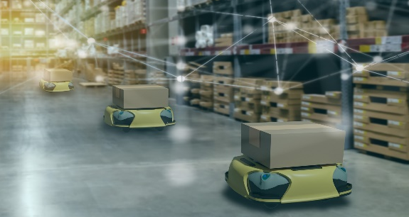
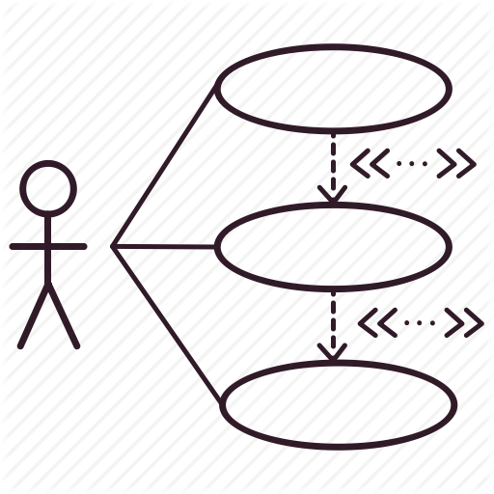
Usage Scenarios and Use Cases
Critical Infrastructure
Scenario
Service Robotics
Scenario
Smart Water
Infrastructure
Smart
Warehouse
Critical Infrastructure
- Service Robotics

Slide 8
Critical Infrastructure for Water Distribution Management
A scenario related to the management of water distribution network from EMALCSA. It focuses on monitoring and control the management of the water urban cycle in metropolitan environment of the city of A Coruña in Spain.
Main challenges
1) Provide decision-making capabilities based on data analysis.
2) Enable integration between different platforms for exchanging data and information.
3) Ensure the security of communication between the water infrastructure platforms and devices in water infrastructure devices.
4) Detect abnormal situations in water infrastructure devices and ensure resilience and reliability.

Slide 9
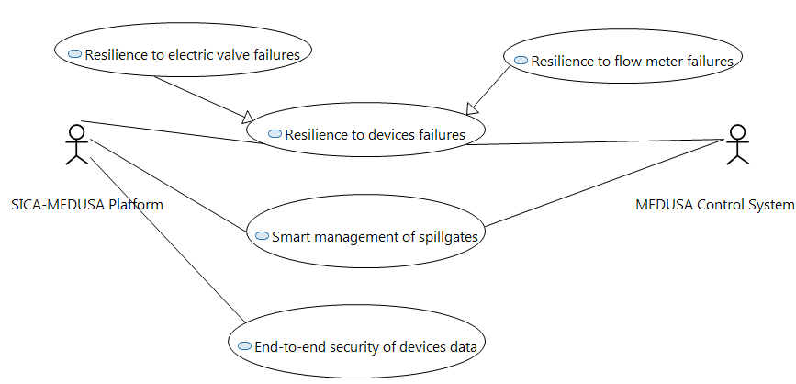
Critical Infrastructure for Water Distribution Management
USE CASES

Slide 10
Benefits of BRAIN-IoT
Critical Infrastructure for Water Distribution Management
Makes data analysis and predictions in real time
Detect of anomalies in the different sensors
Use an alternative control system in the cases of failures
Resilience to devices failures
Enable end-to-end protection in cross-technology networks
Enable strong authentication (with two factor) for IoT sensors/actuators
Optimize key management by using key derivation functions
End-to-end security of devices data
Smart management of spillgates
Predict the amount of outgoing water for the dam
Improve expert decision making on the dam
Manage the communication with the dam infrastructure devices

Slide 11

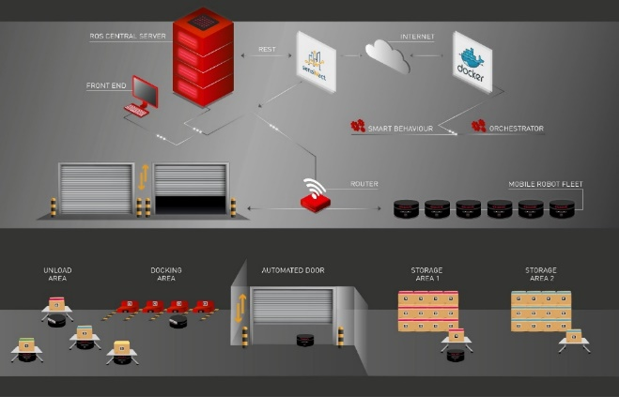
Service Robotics for Warehouse Logistics
A logistic service involving several robotic platforms from ROBOTNIK which need to collaborate to scan a given warehouse and to assist humans in a logistic domain. A fleet of robots supports the movement of different loads in a warehouse.
Main challenges
1) Reduce the development time of robot applications. (UTO 1)
2) Integration of interoperable robot applications and platforms supporting smart cooperative behaviour. (UTO 2)
3) Ensuring data authentication and end-to-end encryption for robot infrastructure devices (UTO 3)
4) Provide tools for monitor and dynamically reconfigure robotic system (UTO 4)

Slide 12
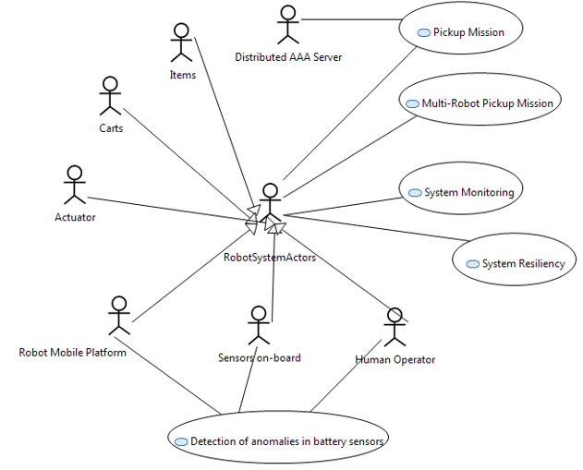
Service Robotics for Warehouse Logistics
USE CASES

Slide 13
Benefits of BRAIN-IoT
Service Robotics for Warehouse Logistics
Facilitating the specification of robots system behaviour
Enabling simulation and validation of robot system
Enabling automatic generation of code and its deployment in execution platform.
Strengthen security of communications
Pickup Mission
Multi-Robot Pickup Mission
Observing the robot states in real time during the operation phase.
Reporting errors in case of robot failures happened.
System Monitoring
Detect anomalies in the battery of the robots, anticipating to a wide range of problems.
Allow the resignation of the robot missions to enable successful delivery
It is able to adapt to different battery capacities and consumptions
Detection of anomalies in battery sensors
System Monitoring
System Resiliency
Permit autonomous redeployment and rebuilding of software that was running on failed compute resources to other hardware

Slide 14


BRAIN-IoT final Architecture

Slide 15
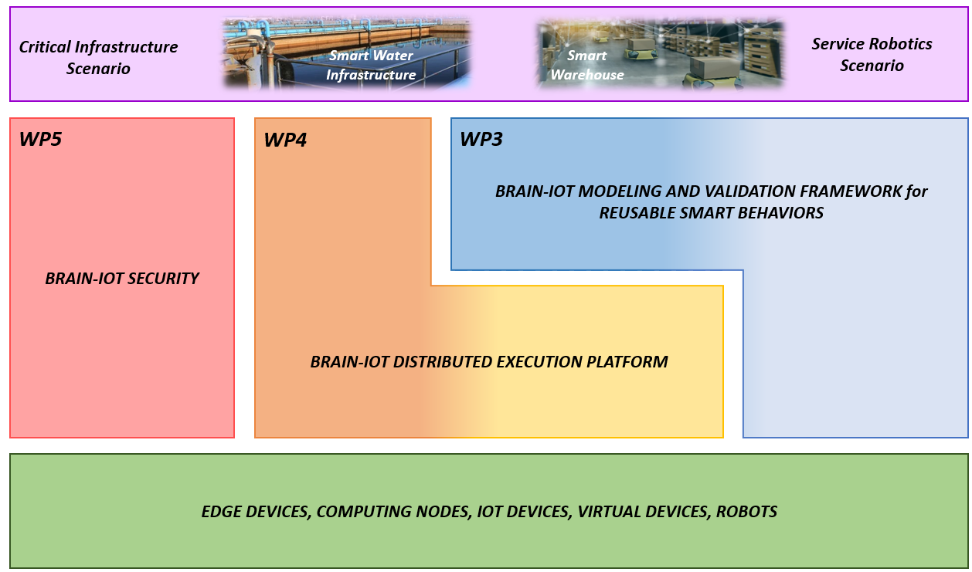
BRAIN-IoT Architecture – Blocks

Slide 16
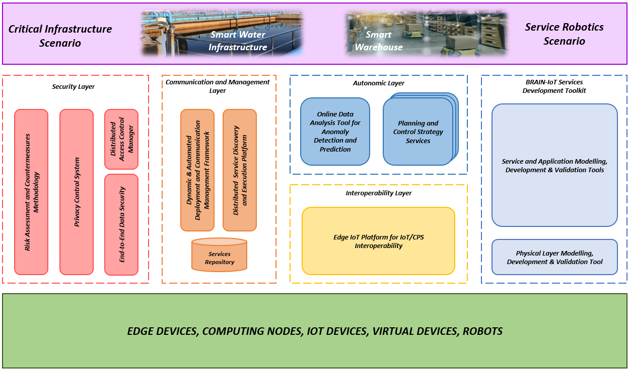
BRAIN-IoT Architecture – Layers

Slide 17
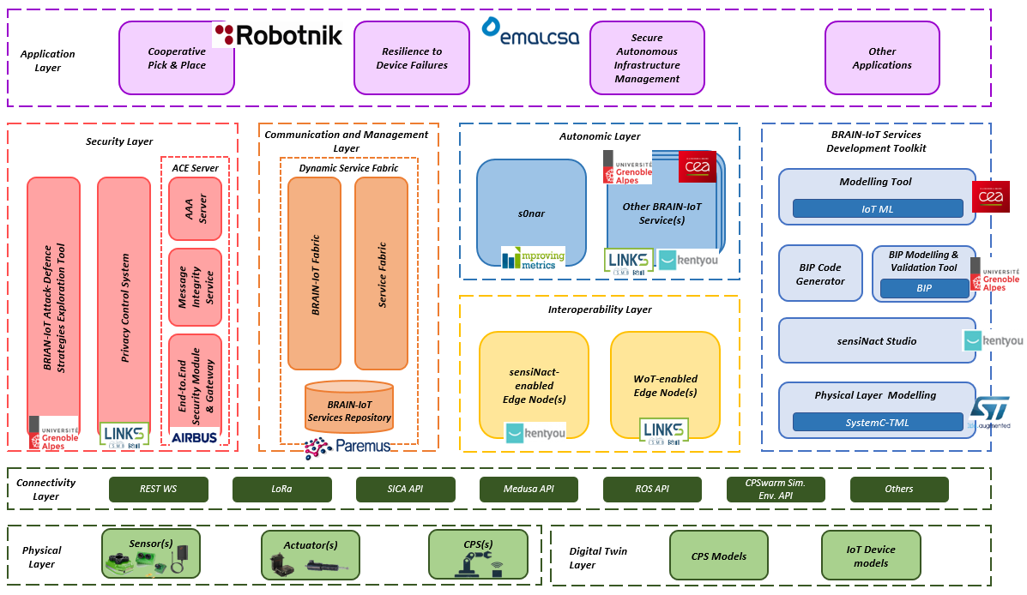
BRAIN-IoT Architecture – ASSETS

Slide 18
INTEGRATED BRAIN-IoT PLATFORM
BRAIN-IoT Services Development Toolkit
s0nar
Deploy
Physical Layer Modelling
Modelling Tool/BIP Modelling & Validation Tool, BIP Code Generator/sensiNact Studio
s0nar
Develop
BRAIN-IoT Services for Planning and Control Strategy
BRAIN-IoT
Services Repository
Modeling
Secure Data
Communication
End-User
IoT Device
Models
Lookup and
Automated
Deployment
s0nar
Privacy
Settings
Virtual IoT/CPS Devices
Privacy
Enforcement
Privacy Control System
Device
Interoperability
Message Integrity Service
BRAIN-IoT Fabric
End-to-end
Data Security
sensiNact/WoT enabled
Edge Node(s)
End-User
Phisical IoT/CPS Devices and external Systems
End-to.End Security Module & Gateway
Service
Discovery & Execution
Service Fabric
Data
Authentication
Security
Manager
AAA Server
IoT Device Models
Manual Deployment,
System Monitoring
Management
Security
Configurations
System
Operator
BRIAN-IoT Attack-Defence
Strategies Exploration Tool

Slide 19
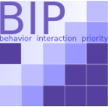

BRAIN-IoT Concept and architecture
8
- Formal Modeling of IoT components behaviors and interactions
Modeling
Functional Modeling
IoT-ML
Deployable on the runtime infrastructure
BIP
Components Modeling
SystemC-TLM
- Formal verification of components models
IoT Devices (HW/SW)
SensiNact
Code Generation
IoT Service
Adapters
AI/ML
features
Implement.
Simulated CPS , IoT Devices and Services
BRAIN-IoT Fabric
Distributed Self-Adaptive Deployment
Other Stateless
Function Implement.
Edge/Cloud Environment

Slide 20
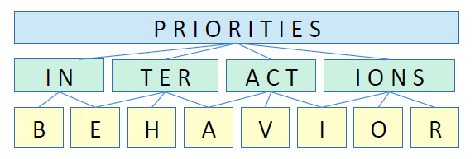
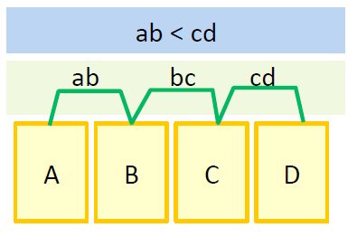
BIP language
- Highly expressive component-based language
- Separation between architecture and behavior
- Complex system modeling and analysis
Components = layered composition of
– Behavior, atomic functional units (automata + code + timing constraints, stochastic semantic)
– Interactions, cooperation between actions of behavior
– Priorities, conflict resolution between interactions

Slide 21
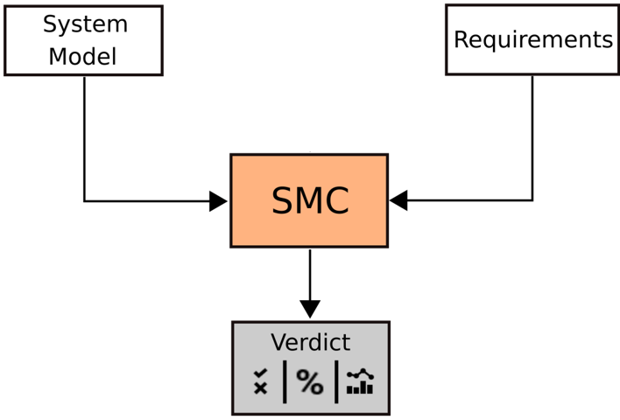
SBIP (BIP-SMC)
-IDE for modeling and analysis of BIP
-Verification using Statistical Model Checking
Stochastic Model
BIP
Properties
LTL/MTL
Quantitative analysis
What is the probability that the system M satisfies the property φ?
Qualitative analysis
Is the probability that the system M satisfies the property φ greater or equal than a threashold θ?

Slide 22
BIP Model : Clock SYNCHRONIZATION (Atom)
Robot (id: int)
S1
synchronize
updateClock()
LOCAL_CLOCK := avg(LOCAL_CLOCK, EXTERN_CLOCK);
LOCAL_CLOCK := LOCAL_CLOCK +1;
Synchronize
(EXTERN_CLOCK, LOCAL_CLOCK)
updateClock
S2

Slide 23
BIP Model : Clock SYNCHRONIZATION (COMPOUND)
Compound()
connector_synchronization (r1.synchronize , r2.synchronize)
synchronize
synchronize
Robot: r1
Robot: r1
‘’ connector_synchronization ‘’ is necessary to link components. So, it needs behavior

Slide 24
BIP Model : Clock SYNCHRONIZATION (CONNECTOR)
In BIP we distinguish two types of connectors:
(1) Broadcast connector : One or multiple ports initiators
Exp: p and q are initiator candidates, Interaction = {p, q, p q}
connector type connector_synchronization (Port_Type_1 p, Port_Type_1 q)
define p' q'
on p
on q
on p q up{ } down { q.EXTERN_CLOCK = p.LOCAL_CLOCK;
p.EXTERN_CLOCK = q.LOCAL_CLOCK; }
end

Slide 25
BIP Model : Clock SYNCHRONIZATION (CONNECTOR)
p’
p’
p’
R1
t1
t3
t4
q’
q’
R2
t2
t4
Broadcast connector

Slide 26
BIP Model : Clock SYNCHRONIZATION (CONNECTOR)
In BIP we distinguish two types of connectors:
(2) Rendez-vous connector : communication occurred only if both ports are enabled
Exp: Interaction = {p q}
connector type connector_synchronization (Port_Type_1 p, Port_Type_1 q)
define p q
on p q up{ } down { q.EXTERN_CLOCK = p.LOCAL_CLOCK;
p.EXTERN_CLOCK = q.LOCAL_CLOCK; }
end

Slide 27
BIP Model : Clock SYNCHRONIZATION (CONNECTOR)
p’
p’
p’
R1
t1
t2
t3
q’
q’
q’
R2
t1
t2
t3
Rendez-vous connector

Slide 28
Inspect BIP model in BIP Editor (switch to the editor)

Slide 29
Statistical model checking

Slide 30
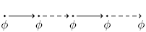
Broadcast connector
Globally: ϕ must be satisfied in all future states.
G{1000} (r1.t==r2.t)
Answer:
False

Slide 31
RENDEZ-VOUS connector
Globally: ϕ must be satisfied in all future states.
G{1000} (r1.t==r2.t)
Answer:
True

Slide 32
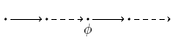
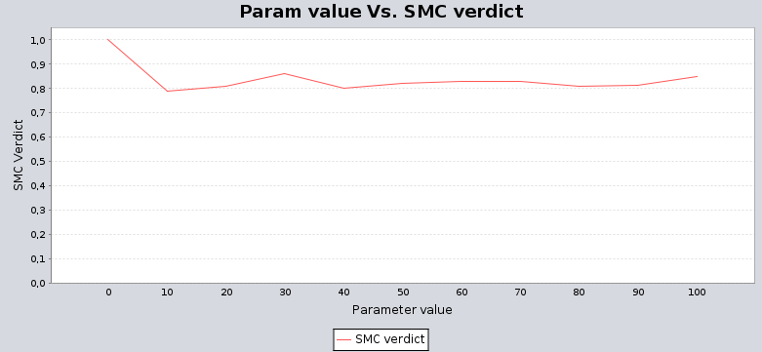
Broadcast connector
Finally: ϕ must be satisfied in a future state.
F{1000} ((r1.t==r2.t) && (r1.t==x))

Slide 33
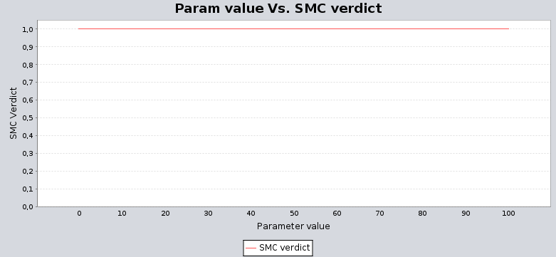
RENDEZ-VOUS connector
Finally: ϕ must be satisfied in a future state.
F{1000} ((r1.t==r2.t) && (r1.t==x))

Slide 34
Part 2 : IoT concepts and architecture
IOT CONCEPTS
Reference ARCHITECTURE

Slide 35







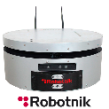
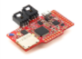
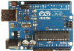
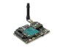
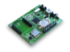
IoT concepts
Virtual Entities
Digital World
SW
SW
SW
SW
SW
SW
SW
SW
Physical World
R
R
R
R
R
Resource
Devices

Slide 36
IoT concepts
Virtual Entities
Digital World
SW
SW
SW
SW
SW
SW
SW
SW
Service
Service
Service
Service
Service
Physical World
R
R
R
R
R
Devices

Slide 37





IoT concepts
Virtual Entities
Digital World
SW
SW
SW
SW
SW
SW
SW
SW
Gateway
Service
Service
Service
Service
Service
Physical World
R
R
R
R
R
Devices

Slide 38
A short recap
Virtual entity : a synchronized representations of the device entity
Resource : an executable code available at the device
Service : a standardized interface for interacting with devices

Slide 39


Reference Architecture
Application
Virtual Entities
SW
SW
Designer
SW
Services
Communications
Devices

Slide 40
A short recap
Application : user defined software that interacts with virtual entities
Communications : A set of protocols to interact with physical entities
Devices : a set of sensors and actuators composing the physical entities

Slide 41
Part 3 : PROJECTION OVER A REAL CASE STUDY
REQUIREMENTS
CHECKING PROCESS
BIP MODEL
Verification AND SIMULATION

Slide 42
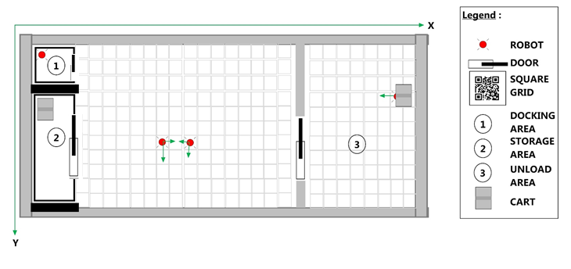
Projection over a real case study
RB-2 BASE
PATHS : → Collecting the cart
→ Lift the cart
→ Task completed
1
3
3
2
2
1
Corkscrew Motion

Slide 43
Requirements : An example
REQ : What is the probability that the robot move from a docking area to storage area ?.

Slide 44
How To check it: Need a process
C/C++
BIP Model
LTL properties
IoT service
Statistical Model Checking
Analysis
no
yes
Code Generation

Slide 45
How To check it: Need a process
C/C++
BIP Model
LTL properties
Statistical Model Checking
Analysis
no
yes
Java Artefacts
Code Generation

Slide 46


BIP model : Identify virtual entities & THE APPLICATION
ROBOT
DOOR
The ROBOT ORCHESTRATOR

Slide 47
Bip Model: The ROBOT virtual entity
Robot (id: int)
collisionResolved()
openDoor()
init
openDoor()
unloadLocation()
storageLocation()
dockingLocation()
S1
S2
S3
collisionResolved()
resolveCollision()
S4
resolveCollision(position)
doorDetected()
S4
S5

Slide 48
Bip Model: The ROBOT virtual entity
Robot (id: int)
collisionResolved()
openDoor()
init
openDoor()
unloadLocation()
storageLocation()
dockingLocation()
S1
S2
S3
collisionResolved()
resolveCollision()
S4
resolveCollision(position)
doorDetected()
S4
S5

Slide 49
BIP Model : Clock SYNCHRONIZATION (Atom)
Door ( )
Orchestrator ( )
collisionResolved()
openDoor()
init
collisionResolved(
Position1,
Position2,
position3)
resolveCollision(
Position1,
Position2,
position3)
init
Resolved
Collision
openDoor()
resolveCollision()

Slide 50
Requirements : REQ1
REQ : What is the probability that the robot move from a docking area to storage area ?.
Until: ϕ1 must be satisfied in all states until a state where ϕ2 is satisfied.
………………..
ϕ1
ϕ1
ϕ1
ϕ2
(r1.p==1) U{1000} (r1.p==3)
Result: Switch to SMC-BIP interface

Slide 51
Requirements : REQ 2
REQ : What is the probability that the collision will happen during the execution at any position ?.
F{1000} ((r1.p==r2.p) && (r1.p==r3.p))
Result: Switch to SMC-BIP interface

Slide 52

Service robotic (ROB) using bundles and event bus
52
Generated Java Code From BIP
Robot
Door
Bundle wrapper
Produced
Java interface
EventBus
Consumed
Java interface
Orchestrator
Xtext, Xtend, felix tools, for exlipse

Slide 53
simulation
Ubuntu-16.04 desktop Intel core i7-950@3.07 GHz and ROS Kinetic
with STAGE and rviz GUI
We use rviz to plan the intelligent robot’s movement within a 3D movement area and STAGE to capture a robot’s movement into 2D plan.

Slide 54
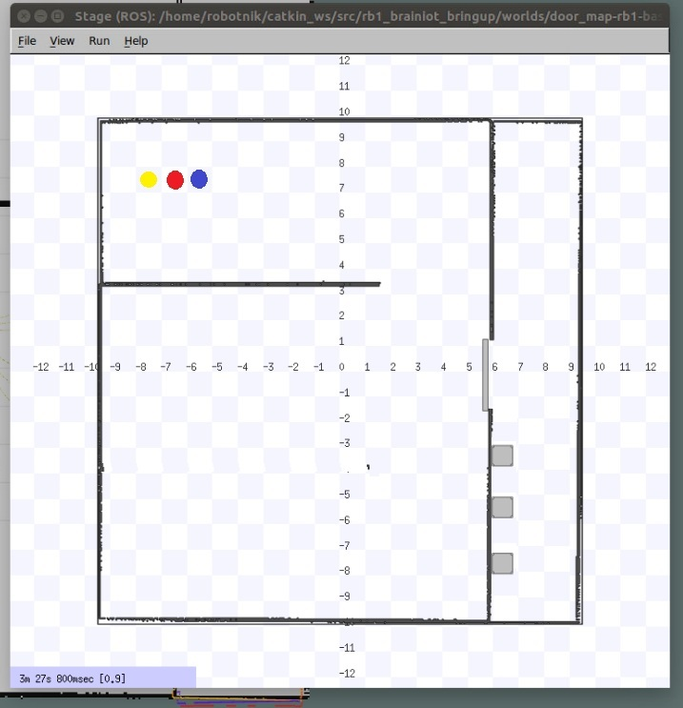
Simulation (Snapshot 1)

Slide 55
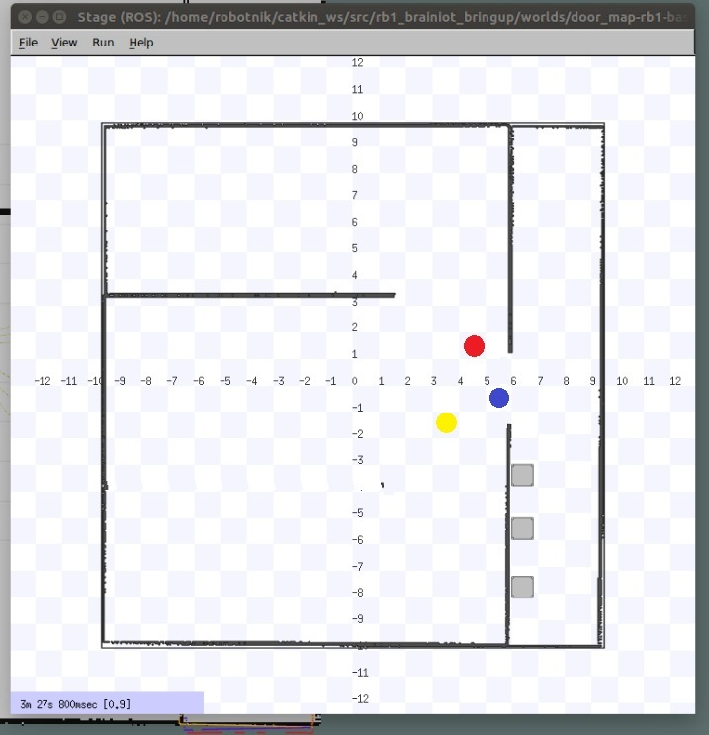
Simulation (Snapshot 2)

Slide 56
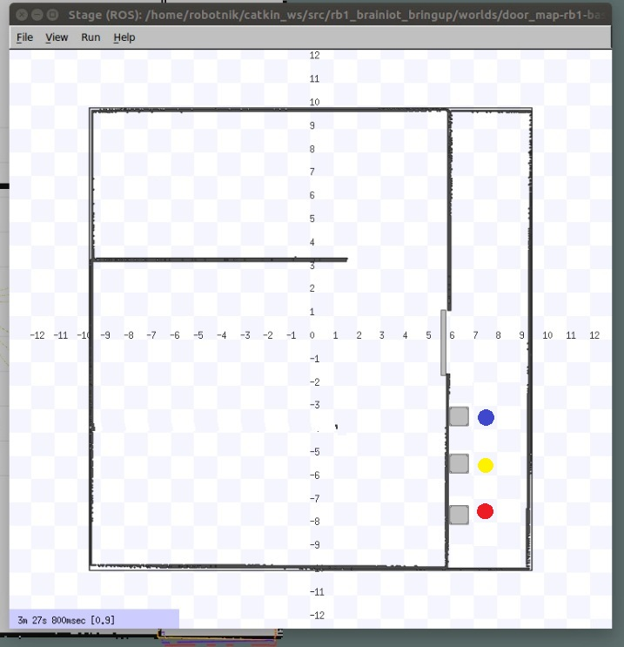
Simulation (Snapshot 3)

Slide 57
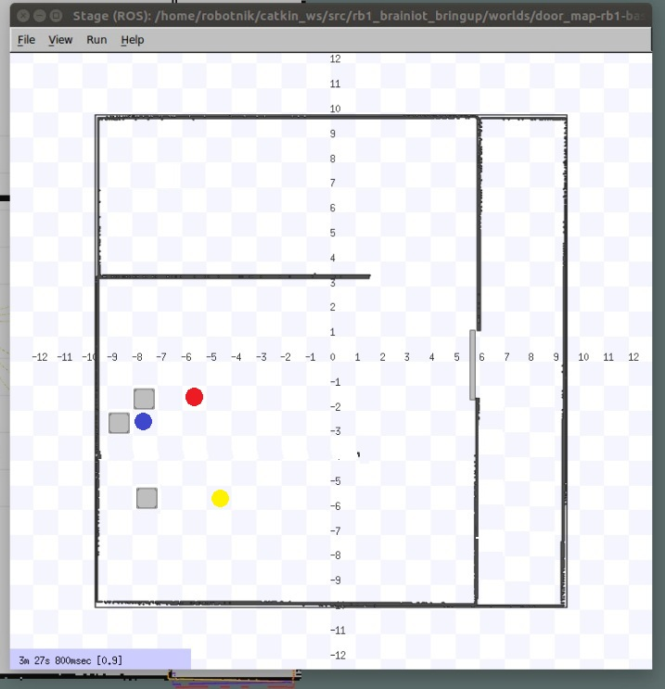
Simulation (Snapshot 4)

Slide 58














contacts
Baouya Abdelhakim
RESEARCHER
EXPERT IN SIRIUS AND ECLIPSE PLATFORM ENGINEER
WEB : http://www-verimag.imag.fr/~baouyaa/
UNIVERSITY GRENOBLE ALPES
abdelhakim.baouya@univ-grenoble-alpes.fr
This project has received funding from the European Union’s Horizon 2020 research and innovation programme under grant agreement No 780089.

Slide 59
contacts
Chehida salim
RESEARCHER
UNIVERSITY GRENOBLE ALPES
Salim.Chehida@univ-grenoble-alpes.fr
This project has received funding from the European Union’s Horizon 2020 research and innovation programme under grant agreement No 780089.

